Slide 1
CUSTOMER RELATIONSHIP MANAGEMENT
CONCEPTS AND TECHNOLOGIES
Chapter 15
Marketing automation

Slide 2
Marketing automation definition
Marketing automation is the application of computerised technologies to support marketers and marketing management in the achievement of their work-related objectives.

Slide 3
Benefits from marketing automation 1
Enhanced marketing efficiency
  The replication of marketing processes delivers greater control over costs. When marketers use manual systems and ad hoc processes, there can be considerable inefficiencies. MA enables companies to develop more streamlined, cost-efficient processes, that can be operated by any marketing incumbent, whether experienced or new-to-role.
Greater marketing productivity
  MA enables companies to run dozens, even thousands of campaigns and events through multiple channels simultaneously.

Slide 4
Benefits from marketing automation 2
More effective marketing.
  MA allows marketers to employ what is known as closed-loop marketing (CLM). CLM is based on a Plan-Do-Measure-Learn cycle.
Enhanced responsiveness.
  Marketers have traditionally created and implemented annual marketing plans with campaigns and promotions planned and scheduled many months ahead. MA allows marketers to respond instantly to opportunities, even if not part of a plan. MA functionality enables companies to engage in real-time marketing, responding immediately to an identified opportunity.

Slide 5
Benefits from marketing automation 3
Improved marketing intelligence.
  MA’s embedded reporting and analytics functionality provides valuable management insights into markets, customers, campaigns, events and so on, leading to both enhanced efficiency and effectiveness.
Improved customer experience.
  Customers receive personalized, relevant communications and offers at appropriate times. MA means less Spam, from the customer’s perspective.

Slide 6
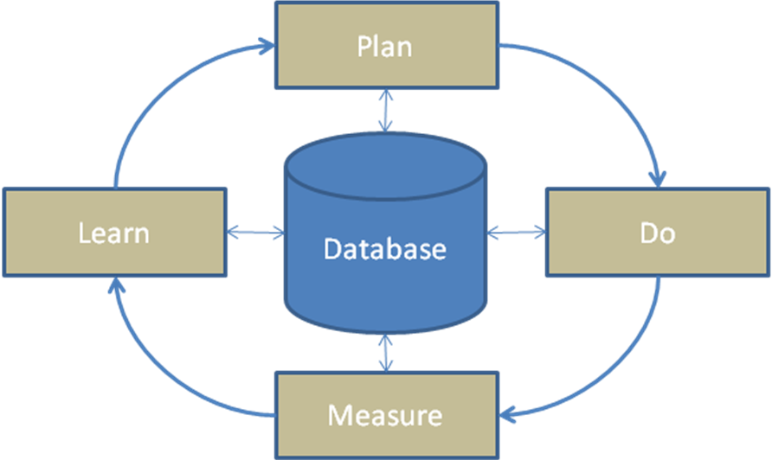
Closed-loop marketing

Slide 7
Functionality offered by MA software
Asset management | Market segmentation
Campaign management | Marketing analytics
Customer segmentation | Marketing optimisation
Direct mail campaign management | Marketing performance management
Document management | Marketing resource management
Email campaign management | Partner marketing
Enterprise marketing management | Product life-cycle management
Event-based marketing | Search engine optimisation
Internet marketing | Tele-marketing
Keyword marketing | Trigger marketing
Lead generation | Web analytics
Loyalty management | Workflow engineering

Slide 8
Asset management
Asset management enables companies to identify and track the assets that customers purchase, license, use, install, or download. Assets can be either tangible, intangible or blended.

Slide 9
Campaign management
Campaign management automates the processes involved in planning, implementing, measuring, and learning from communication programs targeted at prospects or customers. The key elements of campaign management software are workflow, segmentation and targeting, personalization, execution, measurement, modelling and reporting.

Slide 10
Customer segmentation
Customer segmentation is the practice of partitioning customers into homogenous subsets so that each subset can be addressed as a unique marketing audience. This is the foundation of customer portfolio management.

Slide 11
Statistical processes for segmenting customers 1
Among the widely employed statistical processes are cluster analysis, discriminant analysis, CART and CHAID
Cluster analysis aims to sort cases (customers, in this instance) into groups, or clusters, so that the degree of association is strong between members of the same cluster and weak between members of different clusters. Cluster analysis can reveal associations between customers which, though not previously evident, nevertheless are sensible and useful once discovered.

Slide 12
Statistical processes for segmenting customers 2
Discriminant analysis is used to determine which variables discriminate between two or more naturally occurring groups. For example, a marketer may want to investigate which variables discriminate between buyers of standard size packs and buyer of economy size packs. A large number of variables are entered into the statistical routine and discriminant analysis is able to identify the variables which discriminate between purchasers of the two pack sizes. Those variables can then be regarded as predictors of pack size purchase.

Slide 13
Statistical processes for segmenting customers 3
CART (Classification and Regression Trees) is a non-parametric statistical methodology for resolving classification problems involving either categorical (nominal or ordinal) or continuous (interval or ratio) dependent variables. If the dependent variable is categorical (e.g. buy/not buy), CART produces a classification tree. If the dependent variable is continuous (buys x, y ….. n occasion), it produces a regression tree.

Slide 14
Statistical processes for segmenting customers 4
CHAID (Chi-square Automatic Interaction Detection) is used to explore the relationships between a dependent variable (e.g. buyers or non-buyers of a product) and a number of possible predictor variables (such as age, gender, post-code, marital status, income, educational attainment, occupational status) that themselves may interact. The output of a CHAID analysis, in this illustration, is a tree diagram that discriminates between buyers and non-buyers on the basis of the other variables.

Slide 15
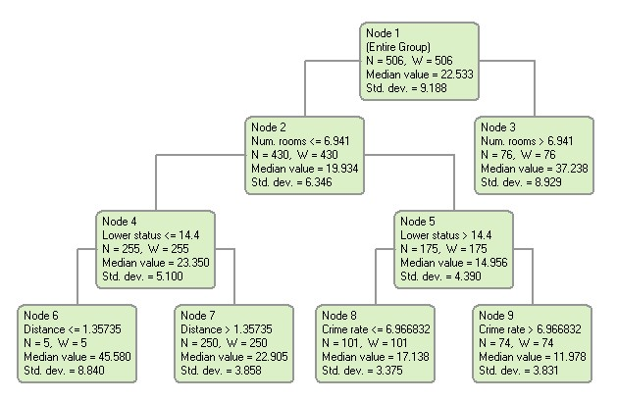
Regression tree output from CART

Slide 16
Direct mail campaign management
Direct mail campaign management is a specific form of campaign management in which the communication medium is direct mail.
Direct mail has many applications including lead generation, lead conversion, building awareness, up-selling and cross-selling, customer retention, database building or image enhancement. Important contributors to direct mail success are the list, the creative execution, the offer, and the timing.

Slide 17
Email campaign management
Email campaign management is a specific form of campaign management in which the communication medium is email.
Email is cheap, easy to use and ubiquitous.

Slide 18
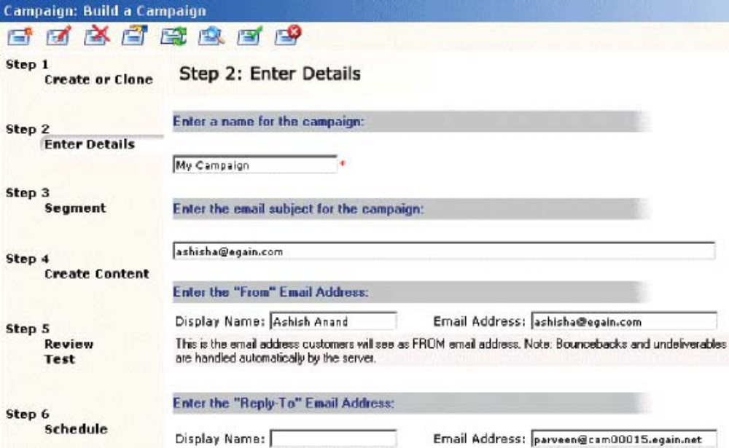
Email campaign management process

Slide 19
Enterprise marketing management
Enterprise marketing management encompasses the business strategy, process automation and technologies required to effectively operate a marketing department, align resources, execute customer-centric strategies and improve marketing performance. It is best-suited for large organizations with 50 or more people in marketing.
This includes functionality for campaign management, lead management, MRM [marketing resource management] and analytics.

Slide 20
Event-based marketing
Event-based marketing occurs when an event triggers a communication or offer. Event-based campaigns are usually initiated by customer behaviours or contextual conditions.

Slide 21
Internet marketing
Internet marketing is the process of creating value by building and maintaining online customer relationships.

Slide 22
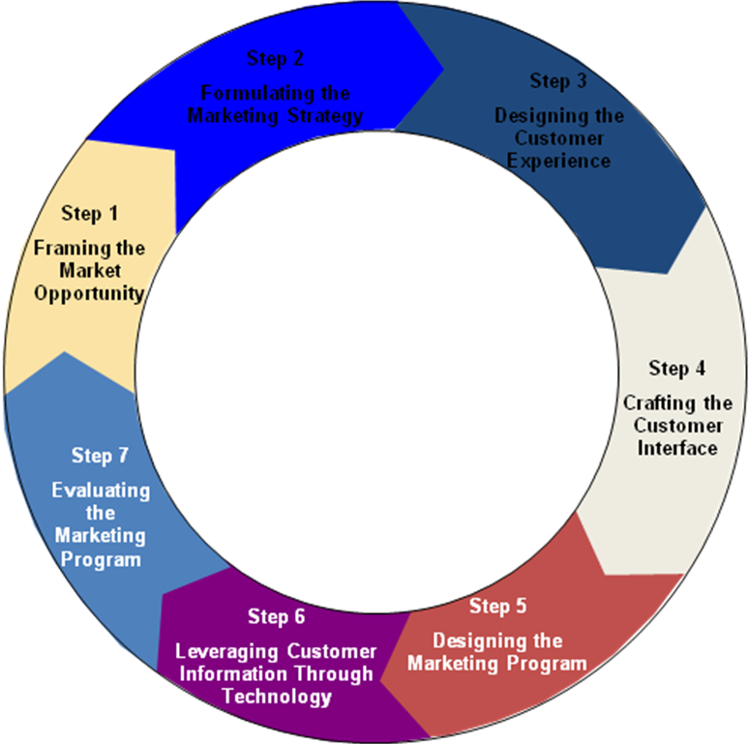
Seven stage cycle of internet marketing

Slide 23
Keyword marketing
Keyword marketing is the practice of generating website traffic from internet users who have entered keywords into search engines such as Google, Yahoo!, AOL, Ask.com and Live search (formerly MSN).

Slide 24
Lead generation
Lead generation is an important marketing objective, particularly in business-to-business contexts. Sales people challenged to grow the numbers of customers served need to be presented with high quality leads for follow-up.
Marketers can deploy campaigns, events, seminars, Webinars and other tactics to generate the leads.

Slide 25
Loyalty management
Loyalty management functionality allows organisations to develop and operate loyalty management programs.
The development of customer loyalty is a goal of many CRM programs. The availability of loyalty management applications is a direct response to this need. Loyalty, or frequency, programs are important to several constituencies – the brand owner who operates the program, the member who collects and redeems credits, and the channel partner who transacts with the member.

Slide 26
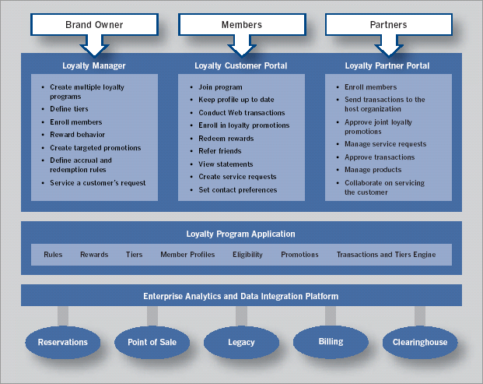

Slide 27
Market segmentation
Market segmentation is the practice of partitioning markets into homogenous subsets so that each subset can be addressed as a unique marketing opportunity.

Slide 28
Marketing analytics
Marketing analytics is the application of mathematical and statistical processes to marketing problems. Marketing analytics can be used to explore, describe and explain.

Slide 29
Marketing optimization
Marketing optimization software allows companies to select an overall goal, such as sales or profit margin maximization, and specify all of the constraints of a marketing campaign strategy
The software then determines which customers should get which offer through which channel to ensure the campaign objectives are met.

Slide 30
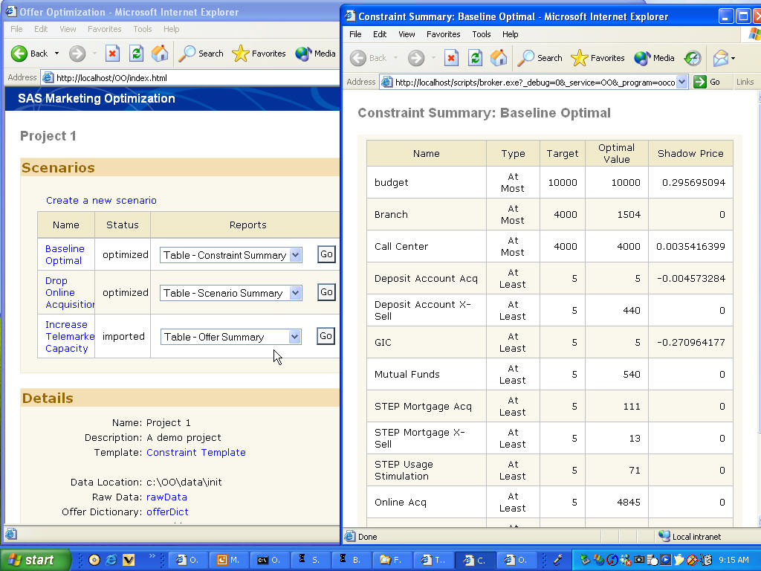
Marketing optimization screenshot

Slide 31
Marketing performance management
Marketing performance management (MPM) software enables companies to measure their marketing performance though analysis and reports, and improve outcomes over time through closed-loop marketing.
Senior management is progressively becoming more demanding that marketers be accountable for their expenditure, and MPM helps marketers meet that expectation. MPM, which is typically focussed on analysis of marketing tactics such as events and campaigns, is routinely built into most MA applications.

Slide 32
Marketing resource management
Marketing resource management applications consist of a range of automated tools that enable marketers to manage their marketing processes and assets more effectively, and to work at greater speed and with improved control. MRM toolkits may include modules for :
  Marketing planning and budgeting, New product launch, Marketing event calendaring, Event planning and registration, Project management, Campaign planning, Collateral production, proofing and approval, Digital asset management, including brands, trademarks, logos and collateral, Expense and budget management, Time management, Media buying, and Procurement

Slide 33
Patrner marketing
Partner marketing solutions enable companies to coordinate and work collaboratively with channel partners and others.
Partner marketing solutions are used to manage processes such as partner qualification and sign up, development of joint business plans and objectives, cooperative advertising and promotions, lead management, co-branding of collateral and point-of-sale materials, measuring partner performance, partner training, administration of marketing funds, and specialist partner incentive schemes.

Slide 34
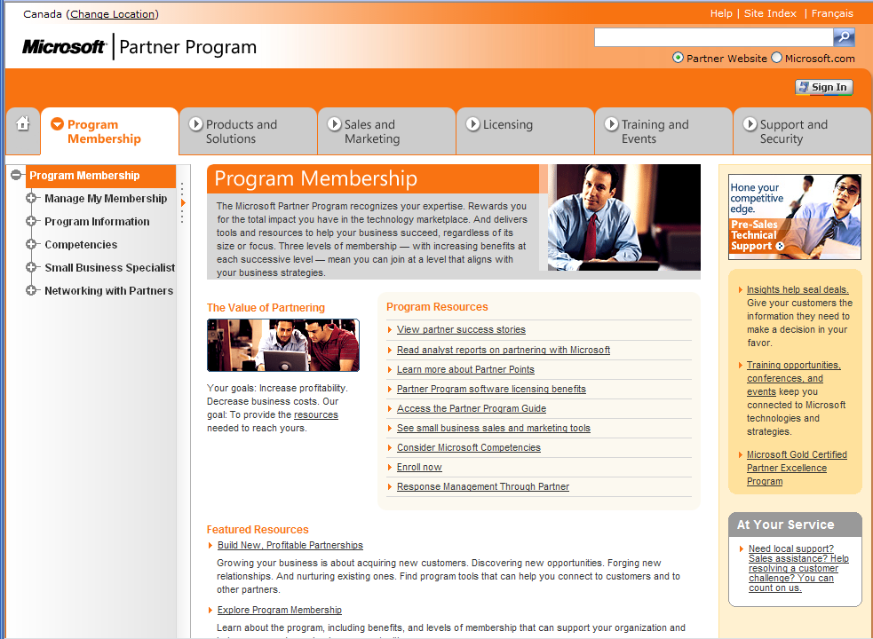
Microsoft Canada’s partner portal

Slide 35
Product life-cycle management
Product life-cycle management (PLM) applications help marketers manage life cycle stages effectively and profitably.
PLM software solutions facilitate collaborative intra- and extra-enterprise engineering, product development, and improved management of projects, product portfolios, documents, and quality. PLM applications can provide a single source of all product-related information to use in the innovation, design, engineering, feasibility, launch and market development processes.

Slide 36
Search engine optimization
Search engine optimization (SEO) is the practice of improving the quantity and quality of website traffic generated by search engines.
Usually, the higher ranking results that appear earlier in the listings generate more visitors. SEO aims, therefore, to achieve high rankings, preferably on the first or second pages.

Slide 37
Tele-marketing
Tele-marketing is the use of the telephone to identify and qualify prospects, and to sell and service the needs of customers.
Tele-marketing takes two forms: inbound (calls from customers) and outbound (calls to customers). Some call centres perform a blended function with agents both making and receiving calls.
Tele-marketing is widely employed in both B2C and B2B environments, but is subject to legislative control due to its intrusive nature.

Slide 38
Tele-marketing fucntionality
Auto-dialling
Predictive dialling
Automated voice-messaging
Contact list management
Agent management
Do Not Call compliance
Screen pop with caller ID
Scripting, including objection response
Computer Aided Telephone Interviewing (CATI)
Interactive Voice Response (IVR)

Slide 39
Trigger marketing
Trigger marketing is the practice of responding to some customer-generated or customer-related event in a way that is designed to achieve some marketing goal such as make a sale, identify a cross-sell opportunity, prevent negative word-of-mouth, or promote positive word-of-mouth. The event triggers the response.

Slide 40
Web analytics
Web analytics report the behavior of website visitors. Routine reports generally detail web traffic data, but may also include performance data from campaigns and events that involve the web site, for example the number of click-throughs from a web-link inserted in a campaign email.
Two main technologies collect data: logfile analysis and page-tagging.

Slide 41
Web analytics terminology
Building block terms: page, page view, visit/session, unique visitor, new visitor, repeat visitor, return visitor
Visit characterization terms: entry page, landing page, exit page, visit duration referrer, internal referrer, external referrer, search referrer, visit referrer, original referrer, click-through, click-through rate/ratio, page views per visit
Content characterization terms: page exit ratio, single-page visit, single page view visits (bounces. Bounce rate
Conversion metrics terms: event, conversion

Slide 42
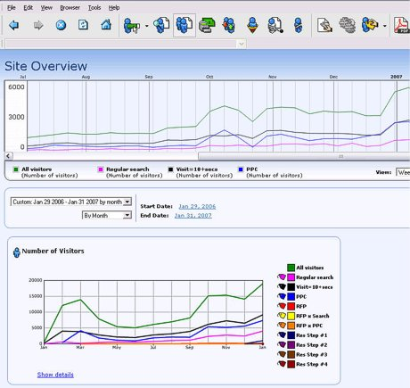
Web analytics report

Slide 43
Work-flow engineering
Work-flow engineering software is useful for designing marketing-related processes, such as the campaigning process, event-based marketing process, or the marketing planning process.

Slide 44
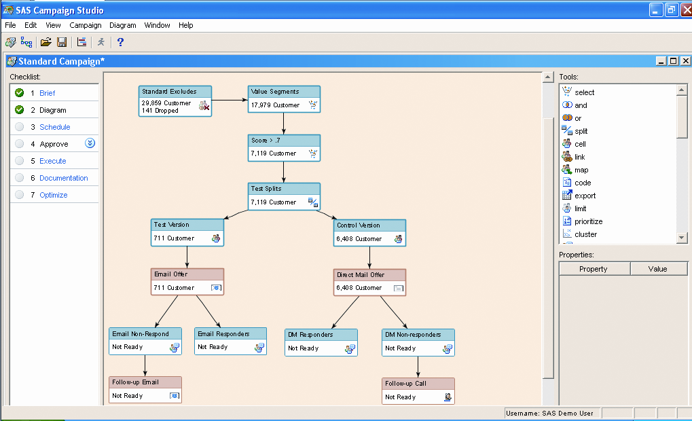
Campaign work-flow screenshot

